Slide 1

RAMAN SPECTROSCOPY
-An Introductory lecture

Slide 2
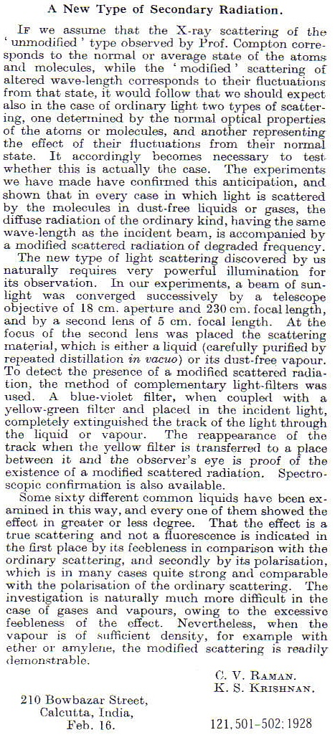
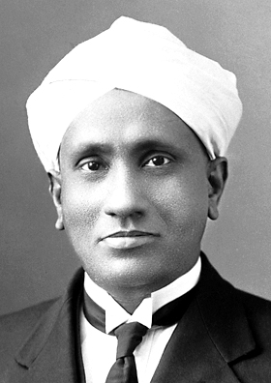
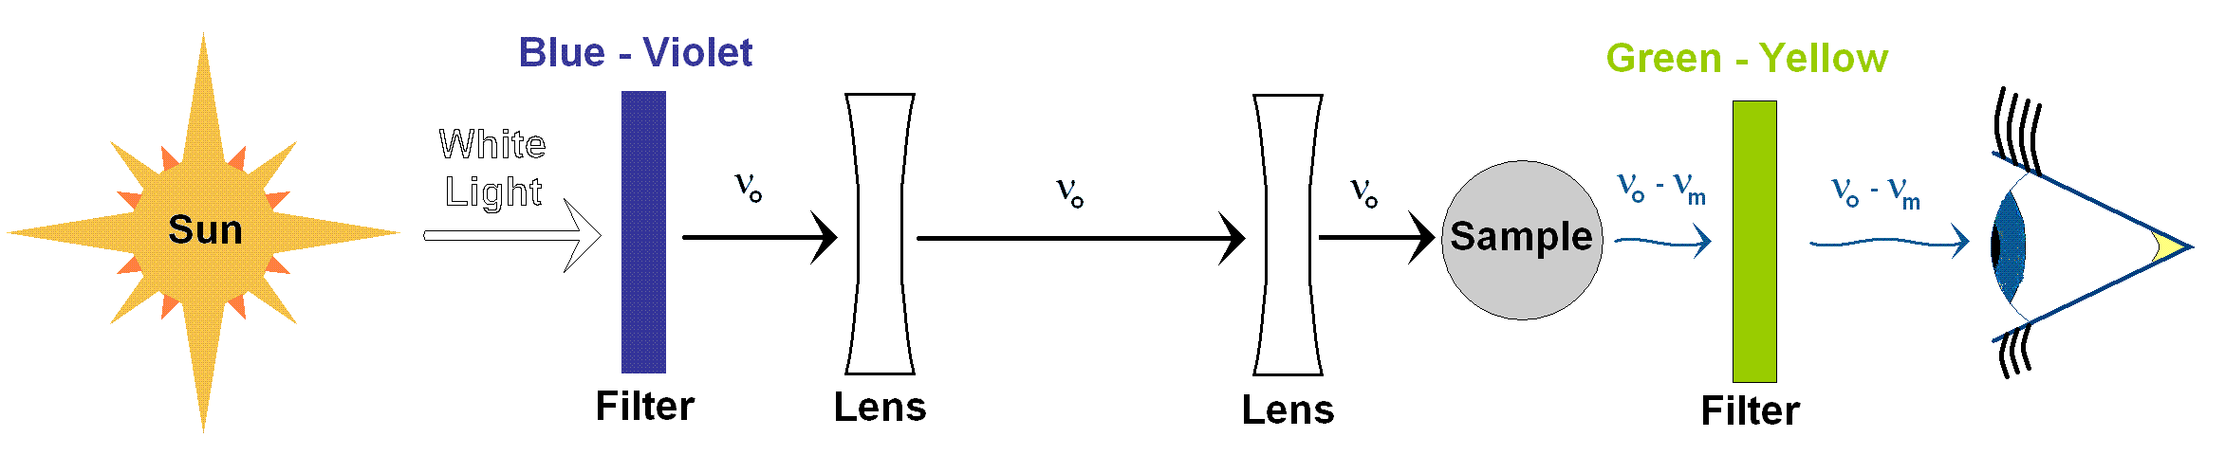
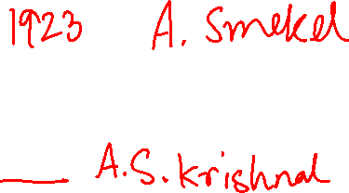
History
Sir. C.V. Raman discovered light scattering in 1928
Awarded Nobel Prize in physics in 1930
Experiment composed of light source (sunlight), a sample, and detector (eye)

Slide 3
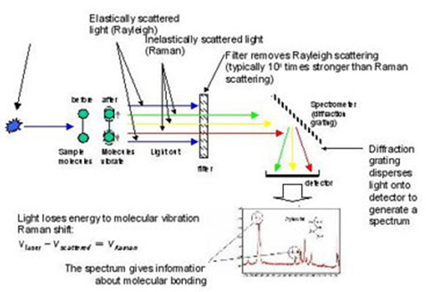
Introduction
Spectroscopic technique – observes rotational, vibrational and other low frequency modes in a system.
Complementary to IR spectroscopic technique.
Inelastic scattering or Raman scattering of monochromatic light

Slide 4
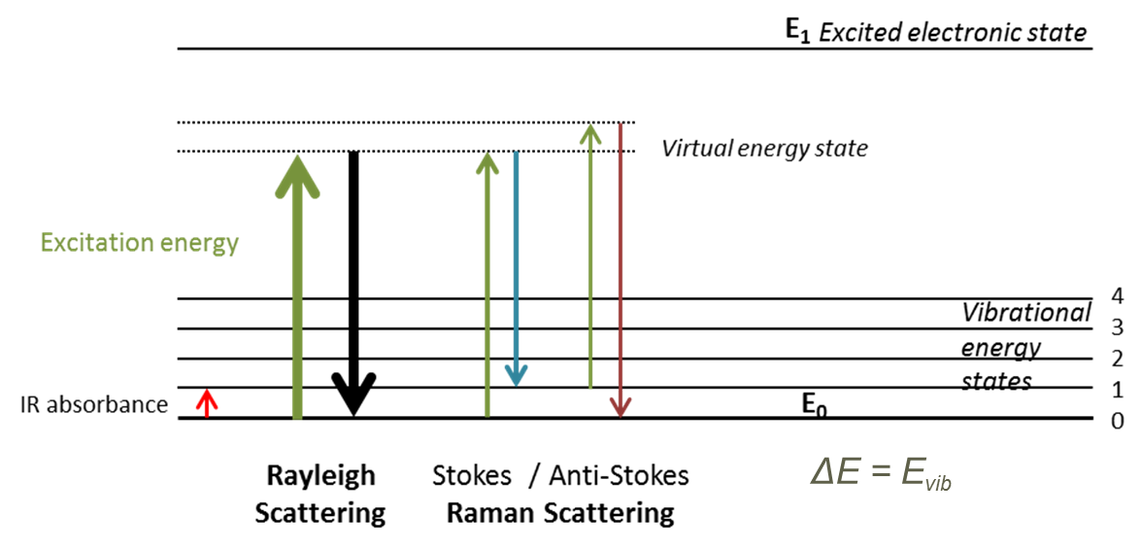
Basic principle
Laser in the visible, near IR and near UV range is used.
Interaction with molecular vibrations – energy of laser photons shifted - the change in energy of the light is measured.
Photons are not absorbed – the energy shift of the incident light indicates presence of characteristic vibrations in the molecule.

Slide 5
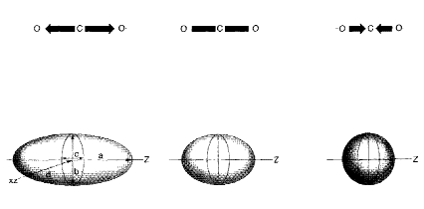
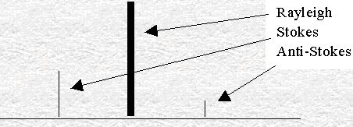
Raman Basics – Selection rule
Excitation of the molecule to a virtual energy state .
Relaxation – energy difference is equal to the energy difference of the new state and the original state of the molecule.
Raman active – molecular polarization potential must change – deformation of electron cloud.
Amount of polarizability change – determines Raman intensity – Differential scattering cross section
Raman scattering intensity is of the order of 10⁻⁷ to 10 ⁻¹⁵ times weaker than the incident photon.
10⁵ times stronger than Raman scattering
Wavenumber (cm⁻¹)

Slide 6
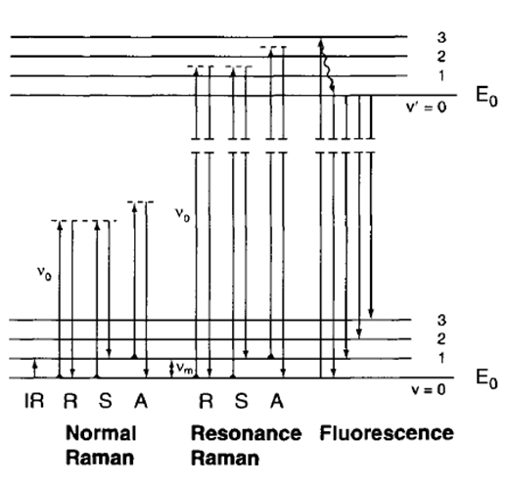
Raman Basics
Raman shifts can be expressed as ν_{o ±} ν_{m}
Stokes and Anti-stokes produce same spectrum, differing in intensity.
Intensity is governed by the
Maxwell-Boltzmann Distribution law
Stokes and Anti-stokes Raman Spectrum of CCl₄
Raman shifts are measured in wavenumbers (cm⁻¹)

Slide 7
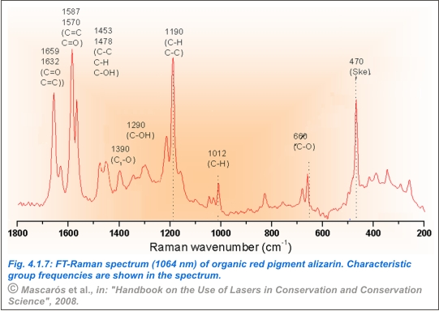
Raman Spectrum

Slide 8
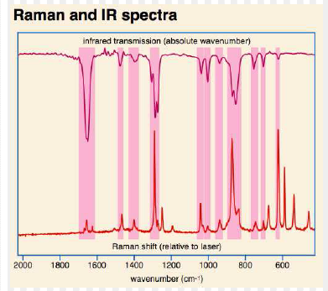
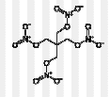
IR and Raman
Spectra of PETN
explosive

Slide 9
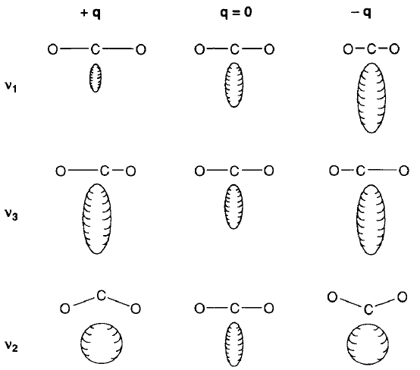
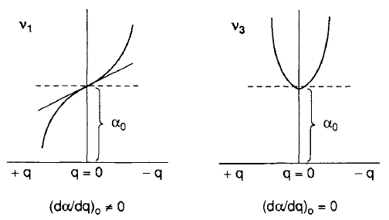

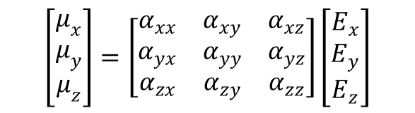
IR and Raman
The polarizability and electric field – tensor quantity.
$$\left[\begin{matrix}μ_{x} \\ μ_{y} \\ μ_{z}\end{matrix}\right]=\left[\begin{matrix}α_{xx} & α_{xy} & α_{xz} \\ α_{yx} & α_{yy} & α_{yz} \\ α_{zx} & α_{zy} & α_{zz}\end{matrix}\right]\left[\begin{matrix}E_{x} \\ E_{y} \\ E_{z}\end{matrix}\right]$$
Any of the component of the
polarizability tensor changes -
vibration is Raman active .
Shape, size or orientation of polarizability ellipsoid changes – vibration is Raman active
Shape change – diagonal elements
Orientation change – off-diagonal elements are changing

Slide 10
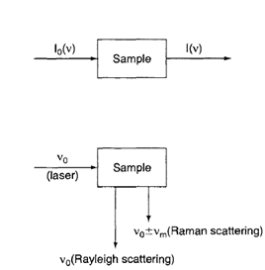
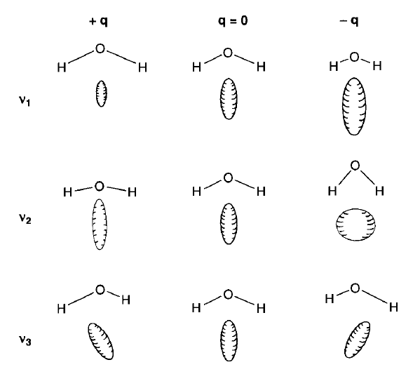
IR and Raman
IR
Raman
Change of polarizability ellipsoid of H2O molecule during each normal mode of vibration
Molecule – center of symmetry – Vibrations are Raman active and IR inactive – the mutual exclusion principle.

Slide 11
Raman – Advantages and Disadvantages
Provides information on vibrational frequencies of a molecule.
Totally symmetric vibrations are always Raman active – mutual exclusion principle – Both Raman and IR active
Covalent bonds are strong in Raman while ionic bonds are strong in IR
Bending vibrations are weaker than stretching in Raman.
Laser beam diameter 1-2mm – very small sample area is used in Raman
Water – no interference in Raman – easy to measure biological samples.
Instrument – expensive – laser source – heating, photodecomposition and fluorescence.

Slide 12
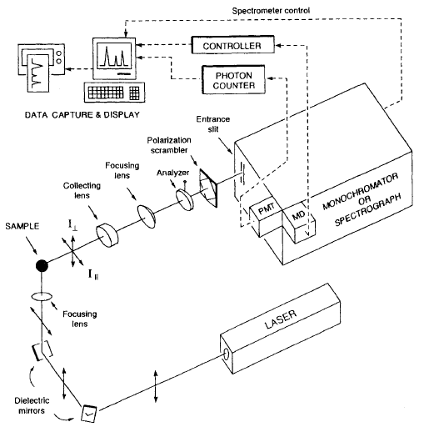
Instrumentation
Excitation source – CW Laser or pulsed laser
Sample illumination and collection system
Wavelength selector
Detection and processing system

Slide 13
Instrumental components
Laser wavelengths ranging from ultra-violet through visible to near infra-red can be used for Raman spectroscopy.
Typical examples include:
Ultra-violet: 244 nm, 257 nm, 325 nm, 364 nm
Visible: 457 nm, 473 nm, 488 nm, 514 nm, 532 nm, 633 nm, 660 nm
Near infra-red: 785 nm, 830 nm, 980 nm, 1064 nm
CW laser: early gas laser Ar+ , Kr+
Pulsed laser: Nd-YAG, diode, excimer laser.

Slide 14
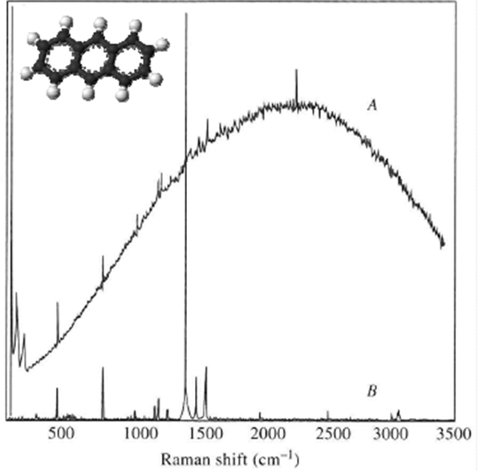
Effect of Laser source
Spectrum of Anthracene
A: Ar+ Laser (514nm)
B: Nd-YAG (1064nm)
Better to use short wavelength (4th power dependence) but long wavelength to avoid fluorescence

Slide 15
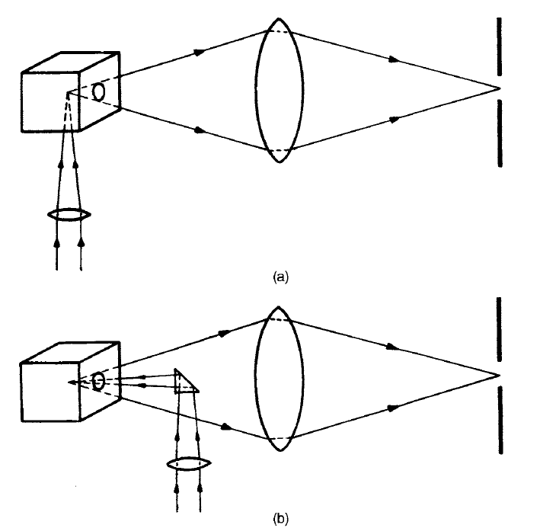
Instrumental components
Sample illumination:
Since very weak intensity of scattering peaks –
90° geometry b) 180° geometry
Collection optics – achromatic lens system with a collecting and a focusing lens.
Wavelength selector – interference filter – monochromator – grating
Detector – detection and amplification – photon counting – photo diode array – Charge coupled devices

Slide 16
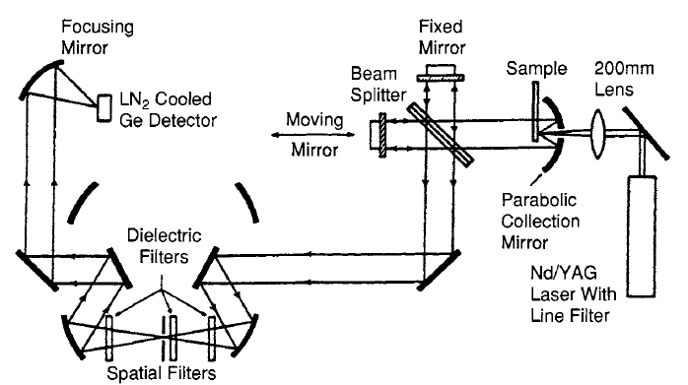
FT-Raman
Optical diagram of FT- Raman spectrometer
Interferometer – optical filter to reduce stray light and Rayleigh line.

Slide 17
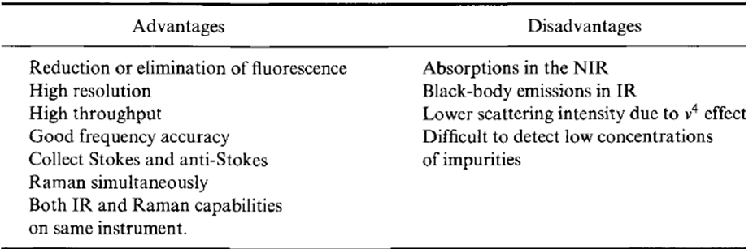
FT-Raman
Will not completely eliminate fluorescence – NIR absorption poses problem for transition metals
Can not displace dispersive Raman
Can not detect ppm concentrations
Above 150° temp. thermal blackbody radiation from sample causes problem – more intense than Raman signal – detector gets saturated.

Slide 18
https://www.youtube.com/watch?v=57hRNhefXPg
https://www.youtube.com/watch?v=hue2TrYXY54

